Slide 1


SMART INVENTORY & ORDER APP
A secure, role-driven platform for efficient order management, inventory control, and business analytics.
PRESENTED BY:
SANJANA BISWAS
DATE : THURSDAY, 8TH JANUARY 2025

Slide 2



Overview
Problem Statement
Proposed Solution
Tech Stack
System Achitecture & DB Design
Core Features & UI Flow
Challenges Faced & Achievements
Learning Outcomes
CONTENT

Slide 3
Project Overview
03/10
Technology Stack:
ASP.NET Core Web API
Angular
SQL Server
Objective :
A full-stack enterprise web application designed to streamline order processing, inventory tracking, and business reporting for a multi-warehouse retail organization.
Project Type:
Full-Stack Capstone Project

Slide 4


05/10
Problem Statement
Business Challenges:
Manual and delayed order processing
No centralized inventory visibility
Poor coordination between sales, warehouse, and finance teams
Lack of analytical insights for decision-making
Need:
A secure, scalable, role-based system that integrates orders, inventory, users, and reports into a single platform
the project is intended.

Slide 5
Proposed Solution
06/10
A modern, API-driven web application with role-based access and real-time data visibility.
Key Highlights:
JWT-based authentication & authorization
Centralized inventory and order lifecycle management
Role-specific dashboards
Analytical reports for business insights

Slide 6
Technology Stack
06/10
Backend :
Frontend :
ASP.NET Core Web API
Entity Framework Core
LINQ
SQL Server
JWT Authentication
SQL Server
Angular
TypeScript
Angular Material
HTTP Interceptors & Route Guards

Slide 7
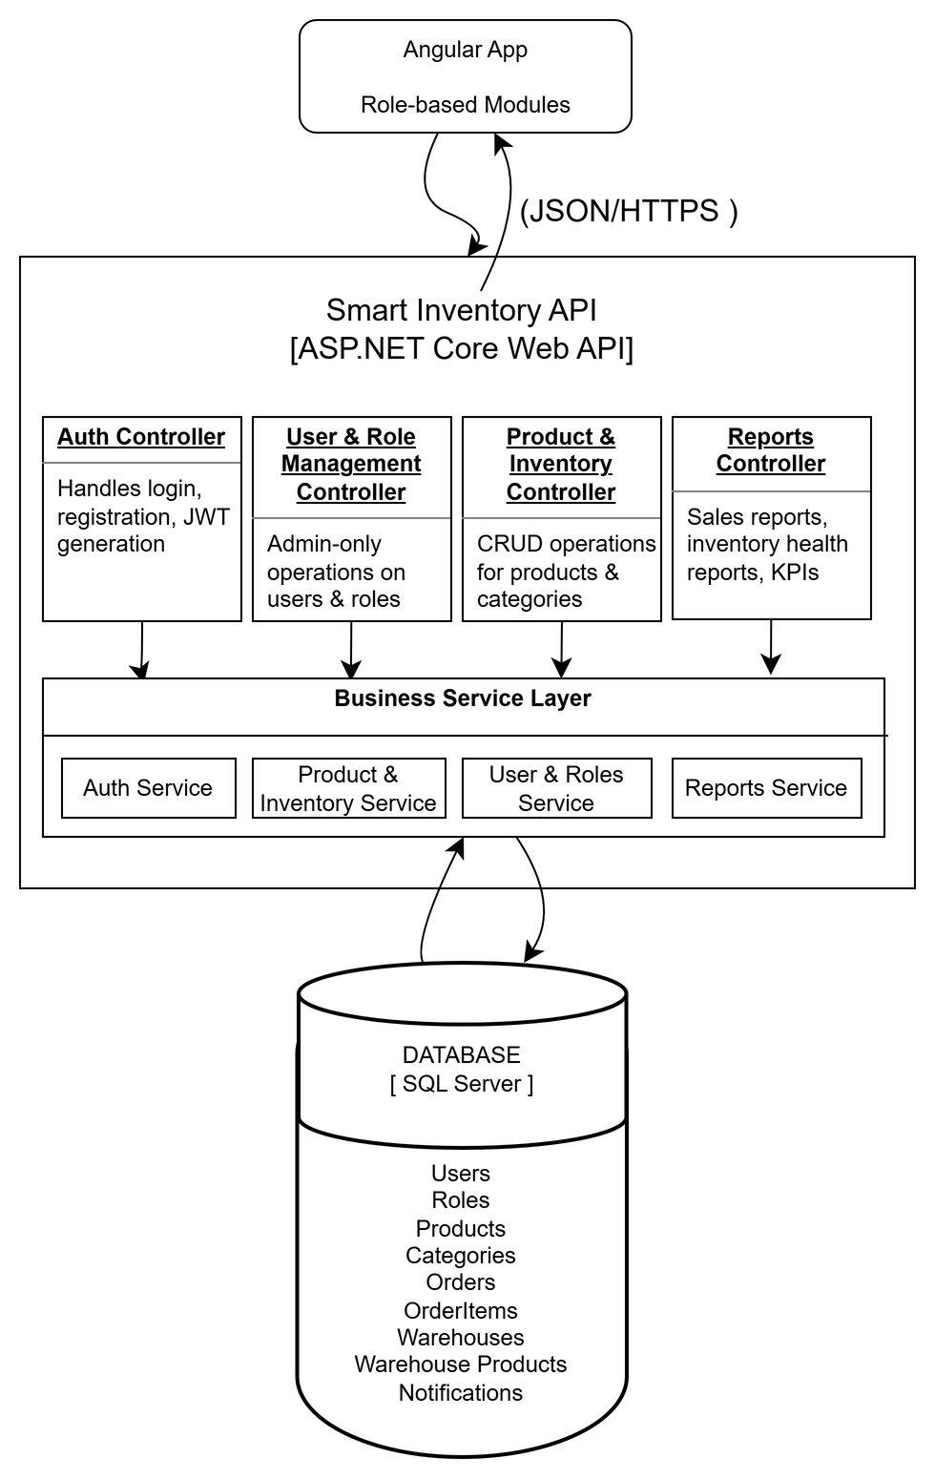
System Architecture
06/10
Architecture Highlights:
Angular frontend communicates via REST APIs
Layered backend architecture
Secure JWT-based authentication
Database accessed only via backend services
Layers:
Controllers
Services
Repositories
Models & DTOs

Slide 8
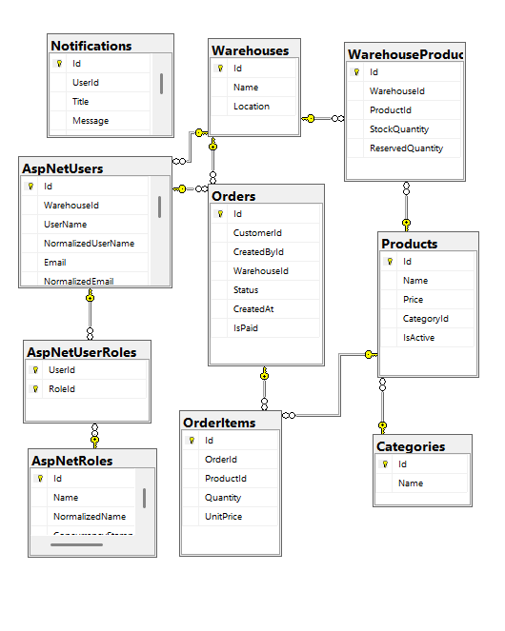
Database Design
06/10
Design Principles:
Normalized relational schema
Clear entity relationships
Foreign keys for data integrity
Separate tables for users, roles, orders, products, inventory
Benefits:
Reduced redundancy
Consistent and scalable data model

Slide 9
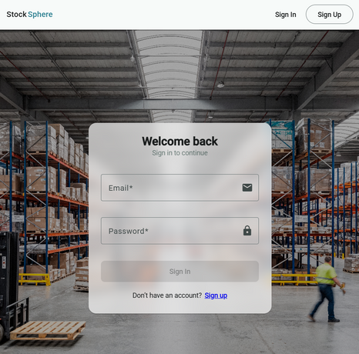
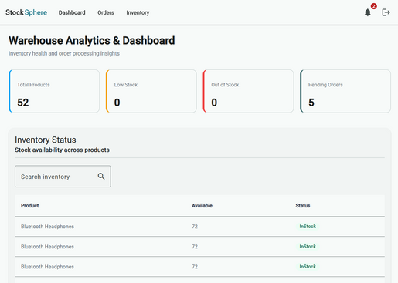
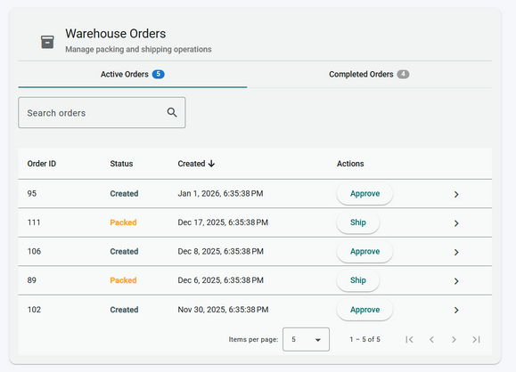
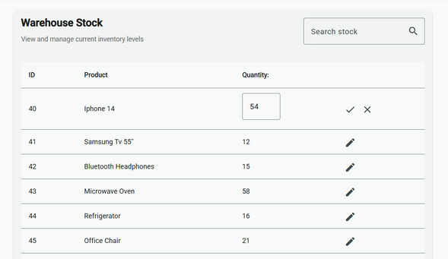
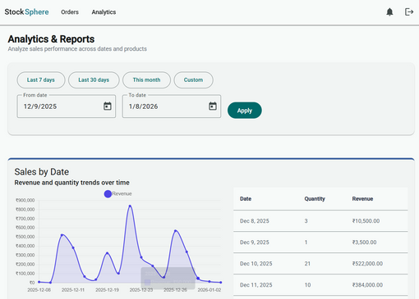
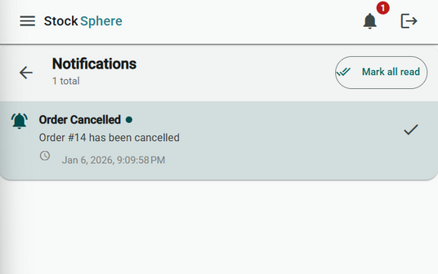
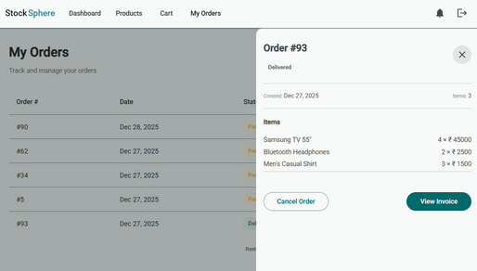
UI Flow
06/10
Application Flow:
Login → Role-based Dashboard
Product & Inventory Management
Order Creation & Tracking
Reports & Analytics

Slide 10
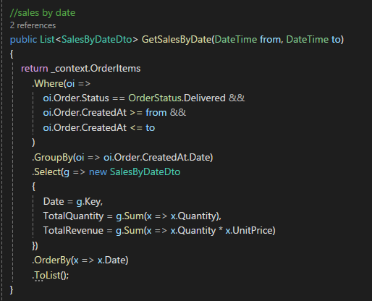
LINQ Usage
06/10
Filtering & sorting orders
Grouping sales data for reports
Aggregations (total sales, stock counts)
DTO projections using Select()
Why LINQ?
Clean, readable, and efficient data querying

Slide 11
Challenges Faced
06/10
Challenges Addressed:
Realistic inventory & order modeling
Preventing inconsistent stock updates
Enforcing business rules cleanly
Secure role-based access
Scalable reporting logic
Approach:
Simplified complex edge cases intentionally
Centralized business logic in services
Designed for extensibility

Slide 12


Timeline
07/10
26-28 DEC
29-31 DEC
1-3 JAN
4-6 JAN
Problem statement explanation & Planning
Backend & Database Design
Frontend Development & Integration
UI Polishing & Github Documentation

Slide 13
LIVE DEMO
08/10

Slide 14
10/10
Thank you
E-mail
sanjanabiswas@557.com
www.reallygreatsite.com

